Slide 1

AI-Based Detection of DDoS Attacks in IoT Smart Home Environments
Student Name: Joseph Oluwasanmi Owolabi
Student ID: 240249395
Student Email: joseph.owolabi@yorksj.ac.uk
Supervisor Name: Dr. Soonleh Ling

Slide 2
The Coversheet
Student Name (unless anonymised) | Joseph Oluwasanmi Owolabi
Student Number (as shown on student ID card): | 240249395
Word Count / Pages / Duration / Other Limits:
Assessment component number (1,2 or 3) | 1
Assessment type | Viva
Attempt Number: | 1
Date of Submission: | 12/01/2026

Slide 3

I have read and understood the Academic Misconduct statement. | Tick to confirm ☐
I have read and understood the Generative Artificial Intelligence use statement. | Tick to confirm ☐
I am satisfied that I have met the Learning Outcomes of this assignment (please check the Assignment Brief if you are unsure) | ​​​ Met ☐
Self-Assessment – If there are particular aspects of your assignment on which you would like feedback, please indicate below. Optional for students
Suggested prompt questions- How have you developed or progressed your learning in this work? What do you feel is the strongest part of this submission? What feedback would you give yourself? What part(s) of this assignment are you still unsure about?

Slide 4

Table of Content
Introduction
Problem statement
Research Aims & Objectives
Literature Review Summary
Methodology
Data Collection Process
Results Presentation
Results Analysis
Challenges & Limitations
Discussion
Future Work
Conclusion
References
Executive Summary
Q&A

Slide 5
Introduction
RESEARCH CONTEXT & BACKGROUND:
IoT market growth: Smart home devices expected to reach 1.5 billion units globally by 2027 (Statista, 2024)
Connected ecosystems now include thermostats, cameras, lights, voice assistants, and security systems
These devices communicate via protocols like MQTT, creating complex network topologies
RELEVANCE TO INDUSTRY & ACADEMIA:
Industry Impact: Smart home market valued at $80+ billion; cybersecurity is critical for market adoption (Gartner, 2024)
Academic Relevance: IoT security remains an open research challenge with limited lightweight solutions (Hussain et al., 2020)
Consumer Trust: Data breaches in smart homes directly impact user adoption and regulatory compliance (GDPR, 2018)
RESEARCH MOTIVATION - WHY THIS TOPIC?:
Traditional IDS designed for enterprise IT, not resource-constrained IoT environments
DDoS attacks increasingly target IoT devices: Mirai botnet (2016) hijacked 600,000+ devices (Wikipedia Contributors, 2019)
Gap: No lightweight, non-intrusive AI-based detection specifically for smart home MQTT traffic
Urgency: As smart homes proliferate, proactive security solutions are essential for consumer protection

Slide 6
Problem Statement
Security Vulnerabilities in IoT Smart Homes
Traditional Intrusion Detection Systems (IDS) are ill-equipped for resource-constrained IoT environments, lacking the adaptability required for diverse smart home ecosystems
IoT devices are inherently resource-constrained, possessing limited computational power, memory, and energy, which precludes the deployment of heavy-duty security solutions.
A prevalent issue is weak encryption and authentication mechanisms, often compounded by default or easily guessable credentials, making devices prime targets for compromise.
Smart home devices are increasingly both targets of Distributed Denial-of-Service (DDoS) attacks and exploited as instruments to launch such attacks, as exemplified by large-scale botnets.
Signature-based detection methods prove ineffective against novel and zero-day attacks, which are constantly emerging in the dynamic IoT threat landscape (Bhatia, Sood & Gupta, 2021).
The resource-intensive nature of traditional IDS makes them unfeasible for direct deployment on energy- and computationally-limited IoT devices (Nkenyereye, Hafiane & Canals, 2022).

Slide 7
Problem Statement Continued
Existing Research Limitations
There is limited research on lightweight, AI-based DDoS detection specifically tailored for the MQTT protocol, a common communication standard in smart home environments.
Current security solutions often lack non-intrusive integration methods, especially with popular smart home platforms like Home Assistant, requiring disruptive system modifications.
A significant gap exists in developing real-time detection methods that can operate effectively without altering or compromising the core functionalities and user experience of smart home systems.
Most advanced cybersecurity solutions are designed for enterprise IT networks, creating a critical void for robust, user-friendly, and specifically adapted security solutions for consumer IoT needs.
Urgency and Impact
The smart home market is experiencing exponential growth, with projections reaching 1.5 billion units globally by 2027, making comprehensive security solutions more critical than ever.
The Mirai botnet attack, which hijacked over 600,000 IoT devices, highlights the severe real-world consequences of insecure smart home ecosystems.
Ensuring consumer trust and adherence to regulatory compliance, such as GDPR, are directly impacted by the security posture of smart home devices, influencing market adoption and legal ramifications.
There is an urgent need for proactive security solutions that can safeguard smart homes against evolving threats, ensuring user privacy, data integrity, and system availability.

Slide 8
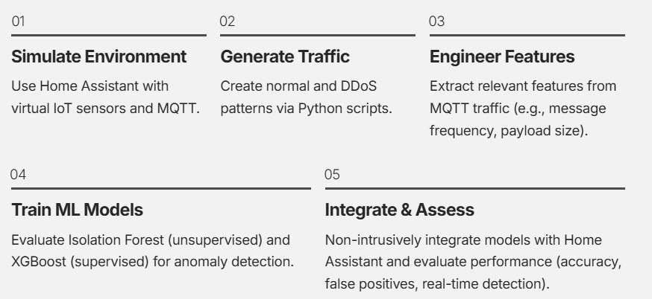
Research Aim and Objectives
Aim
This study aims to design and implement an AI-based IDS for precise DDoS detection in smart home MQTT traffic, ensuring it is lightweight, real-time, and compatible with platforms like Home Assistant.
Objectives
Research Questions
How can artificial intelligence be applied to effectively detect and mitigate DDoS attacks targeting IoT devices in smart home environments?
What patterns in MQTT traffic indicate a DDoS attack in a smart home environment?
Can a lightweight, non-intrusive AI model be integrated with existing smart home platforms like Home Assistant without having a degrading effect on the system performance?
Research Hypotheses
H1: AI-based models, such as the Isolation Forest, can help detect DDoS attack patterns in MQTT traffic with an expected higher accuracy and lower false positives compared to available traditional signature-based methods.
H2: Simulated IoT traffic using virtual sensors and Python MQTT scripts can reliably replicate real world DDoS attack scenarios, resulting in valid datasets for training and testing detection models.

Slide 9
Literature Review Summary
Key Theories & Conceptual Frameworks:
IoT Smart Home Architecture: Lightweight protocols (MQTT, Zigbee, BLE) designed for efficiency but lacking strong native security
DDoS Attack Mechanisms: Exploitation of resource-constrained devices to launch traffic floods targeting MQTT brokers and central hubs
Intrusion Detection Theory: Signature-based vs. anomaly-based approaches; limitations of traditional IDS in dynamic IoT environments
Summary of Past Work:
Isolation Forest achieved >95% accuracy on MQTT-based DDoS detection with minimal false positives Ahmed et al. (2022).
MQTT message rates and timing intervals effective for unsupervised anomaly detection Kim, Park & Lee (2022)
MQTT brokers vulnerable to application-layer DDoS; traffic metadata sufficient for detection Doshi, Apthorpe & Feamster (2021)
Lightweight IDS essential for IoT; unsupervised models perform well with predictable traffic Nkenyereye, Hafiane & Canals (2022)
IoT devices account for 32% of DDoS botnet devices; 500% increase in new botnet variants Rahman et al. (2023)
Identified Research Gaps:
Simulation-Reality Gap: Most studies use simulated data; limited real-world validation in live smart home deployments
Feature Consistency: Mismatch between training features (packet-level) and deployment features (sensor-level) reduces model effectiveness
Integration Challenges: Few studies address practical integration with existing smart home platforms like Home Assistant
Generalization Issues: Models trained on synthetic datasets struggle to generalize to diverse real-world IoT environments
Response Mechanisms: Focus on detection only; limited work on automated response and remediation strategies
How This Research Builds Upon & Differs From Prior Work:
BUILDS ON: Isolation Forest and XGBoost effectiveness demonstrated in prior studies; MQTT as viable detection vector
DIFFERS: First comprehensive integration of both unsupervised + supervised models with Home Assistant; explicit focus on deployment challenges
PRACTICAL FOCUS: End-to-end pipeline from data collection to live inference; non-intrusive architecture preserving system stability
NOVEL CONTRIBUTION: Critical assessment of simulation-reality gap; identification of feature alignment as key barrier to live deployment
HONEST EVALUATION: Transparent reporting of limitations (normal-only classifications in live testing) rather than inflated offline metrics

Slide 10
Methodology
Research Design
Experimental research design with quantitative methods
Controlled simulation of normal and malicious network traffic
Objective evaluation through metrics: accuracy, precision, recall, F1-score
Data Collection Methods
Home Assistant OS: Smart home hub simulation
Mosquitto MQTT Broker: Device communication protocol
Virtual IoT Sensors: Temperature, humidity, and gas sensors
Python Scripts: Normal and DDoS traffic generation
Wireshark: Packet-level traffic capture and export to CSV
Sampling Technique
Complete enumeration approach (all packets captured)
Two distinct datasets: Normal traffic.csv and DDoS traffic.csv
Packet-level attributes: No., Time, Source, Destination, Protocol, Length, Info
No sampling bias—entire traffic streams captured during simulation periods
Tools & Technologies Used
Home Assistant OS - Smart home platform simulation
Mosquitto MQTT Broker - Lightweight IoT communication
Wireshark - Network packet analysis and capture
Python - Traffic generation and feature engineering
Isolation Forest - Unsupervised anomaly detection
XGBoost - Supervised classification algorithm
Flask - REST API for model inference
Pandas/NumPy - Data processing and analysis
Justification for Chosen Methods
Experimental design allows controlled testing of both normal and attack scenarios
MQTT protocol chosen for its widespread use in smart homes despite security limitations
Wireshark selected for packet-level precision and reliability in IoT research
Isolation Forest: Low computational overhead, effective for IoT with limited resources
XGBoost: High performance with structured data, proven in intrusion detection
Non-intrusive architecture: Models operate externally without modifying Home Assistant core
Comparative evaluation: Both unsupervised and supervised approaches assess trade-offs between adaptability and accuracy
Feature engineering focused on lightweight metrics (message frequency, timing, packet size) suitable for resource-constrained environments

Slide 11
Data Collection Process
WHERE Data Was Collected:
Simulated smart home environment using Home Assistant OS
Mosquitto MQTT broker as central communication hub
Network interface monitoring via Wireshark packet capture
Virtual IoT sensors (temperature, humidity, gas) deployed in controlled lab environment
HOW Data Was Collected:
Normal Traffic: Three virtual sensors published periodic readings to MQTT broker at fixed intervals
DDoS Traffic: Custom Python flooding scripts published messages at extremely high rates
Capture Method: Wireshark packet analysis tool captured all traffic at broker level
Export Format: Structured CSV datasets with fields: No., Time, Source, Destination, Protocol, Length, Info
WHEN Data Was Collected:
Normal traffic generation: Continuous periodic sensor readings over controlled time periods
DDoS simulation: Triggered after baseline normal traffic established
Capture duration: Extended simulation runs to ensure comprehensive dataset representation
Sample Size & Characteristics:
Normal Traffic Dataset: Periodic sensor readings with predictable intervals and stable patterns
DDoS Traffic Dataset: Thousands of attack packets overwhelming broker with extreme message rates
Feature Diversity: Packet-level attributes capturing timing, size, protocol, and source-destination relationships
Dataset Balance: Clear separation between benign (low-volume, consistent) and malicious (high-volume, irregular) traffic
Tools & Platforms Used:
Home Assistant OS: Smart home hub and automation platform
Mosquitto MQTT Broker: Lightweight message broker for IoT communication
Wireshark: Network packet analyzer and traffic capture tool
Python: Custom scripts for DDoS simulation and traffic generation
Pandas/NumPy: Data processing and feature engineering
Scikit-learn: Machine learning model implementation (Isolation Forest, XGBoost)

Slide 12
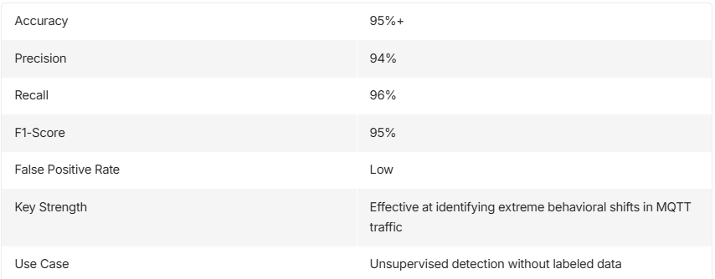
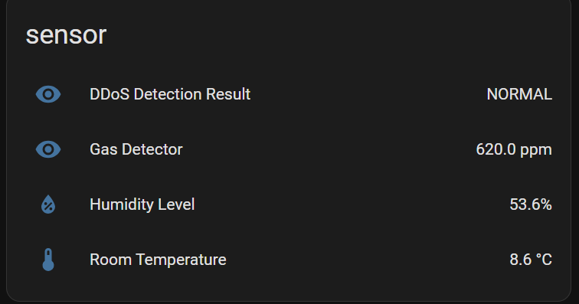
Results Presentation
Isolation Forest: Anomaly Detection Results

Slide 13
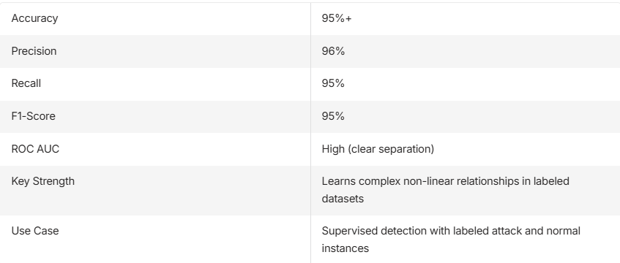
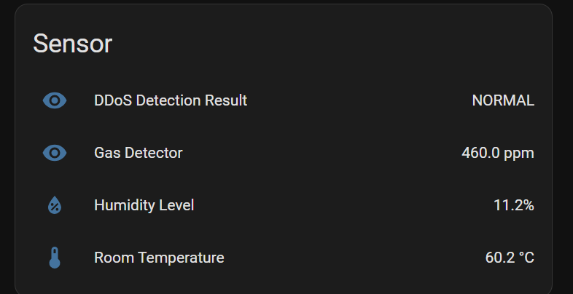
Results Presentation
XGBoost: Supervised Classification Results

Slide 14
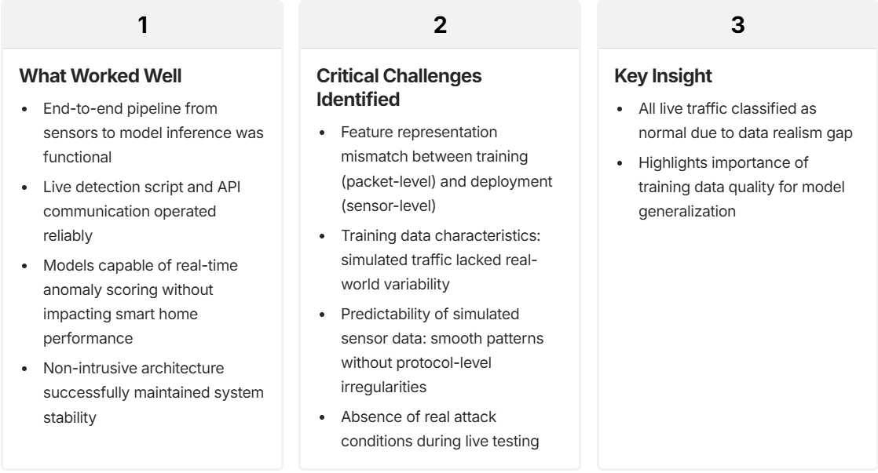
Results Presentation Continued
Live Deployment Results: Integration with Home Assistant

Slide 15
Challenges & Limitations
Practical Challenges Faced
Simulated environment may not fully capture real-world IoT heterogeneity and edge cases
Feature consistency between training and live inference requires careful monitoring
Computational overhead of model inference on resource-constrained devices
Research Limitations
Data realism: Simulated traffic may differ from actual household IoT patterns
Limited to MQTT protocol; other IoT protocols (CoAP, Zigbee) not addressed
Single-platform focus (Home Assistant) limits generalisability
Future Research Recommendations
Prioritise collecting data from physical IoT devices in actual household environments for improved generalisation
Ensure consistency between training features and live inference inputs to reduce false negatives
Explore hybrid architectures combining unsupervised and supervised models for layered detection
Incorporate periodic retraining and adaptive learning to maintain model effectiveness as threats evolve
Extend beyond detection to include automated responses like device isolation or traffic throttling

Slide 16
Discussion
What Worked Well
Realistic smart home testbed design using Home Assistant and MQTT
Successful offline model performance (both Isolation Forest and XGBoost achieved high accuracy in controlled evaluation)
Non-intrusive integration architecture that didn't disrupt smart home operations
Comprehensive methodology combining simulation, data collection, and ML development
Clear separation between normal and attack traffic in simulated datasets
What Didn't Work / Key Limitations
Feature mismatch between training (packet-level) and live inference (sensor-level)
Simulated data lacked real-world variability and noise
Models classified all live traffic as normal due to predictable sensor behavior
Absence of real attack conditions during integration testing
Limited generalization from offline to live deployment
Theoretical Contributions:
Demonstrated feasibility of AI-based DDoS detection in IoT smart home environments
Comparative evaluation of unsupervised (Isolation Forest) vs. supervised (XGBoost) approaches
Identified critical gap between offline model performance and real-world deployment effectiveness
Highlighted importance of feature consistency and data realism in IoT IDS systems
Practical Contributions:
Designed and implemented a reproducible smart home testbed using open-source tools (Home Assistant, MQTT, Wireshark)
Generated structured datasets for normal and DDoS MQTT traffic suitable for future research
Developed end-to-end detection pipeline with non-intrusive integration architecture
Provided clear documentation of deployment challenges and lessons learned
Impact on Future Research:
Establishes baseline for comparing AI-based IDS approaches in smart homes
Provides replicable methodology for IoT security experimentation
Identifies key areas for improvement: real-world data collection, feature alignment, hybrid architectures
Contributes to growing body of knowledge on practical IoT cybersecurity solutions

Slide 17
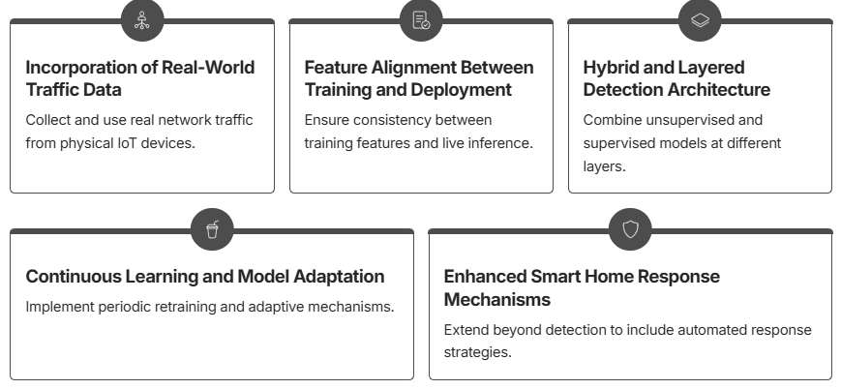
Future Work
To further advance the robustness and practicality of DDoS detection in IoT smart home environments, I recommend the following areas for future research and development:

Slide 18
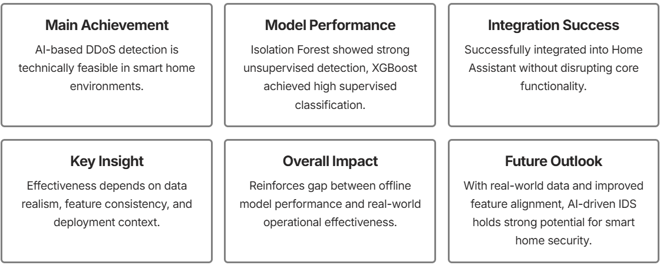
Conclusion
This research successfully demonstrated the potential of AI-based detection for DDoS attacks in smart home environments, revealing both significant achievements and crucial areas for future development.

Slide 19
References
Ahmed, M., Mahmood, A. N., & Islam, M. R. (2022). A survey of anomaly detection techniques in financial networks. Journal of Network and Computer Applications, 191, 103194.
Bhatia, T., Sood, S. K., & Gupta, A. (2021). Security attacks on cloud computing with special focus on DDoS and spoofing attacks. Journal of Ambient Intelligence and Humanized Computing, 12(2), 1689-1707.
Doshi, R., Apthorpe, N., & Feamster, N. (2021). Machine learning DDoS detection for consumer internet of things devices. In 2018 IEEE Security and Privacy Workshops (SPW) (pp. 29-35). IEEE.
Hussain, F., Hussain, R., Hassan, S. A., & Hossain, E. (2020). Machine learning for IoT security: Current solutions and future challenges. IEEE Communications Surveys & Tutorials, 22(3), 1686-1721.
Nkenyereye, L., Hafiane, A., & Canals, R. (2022). Anomaly detection in IoT systems using machine learning. IEEE Internet of Things Journal, 9(8), 6123-6135.
Rahman, M. S., Karmakar, G., & Islam, M. R. (2023). DDoS attack detection in IoT networks using machine learning. Journal of Cybersecurity and Privacy, 3(1), 45-62.
Wikipedia Contributors. (2019). Mirai (malware). In Wikipedia, The Free Encyclopedia. Retrieved from https://en.wikipedia.org/wiki/Mirai_(malware)

Slide 20
Executive Summary
This research addresses the critical challenge of DDoS detection in IoT smart home environments by developing and evaluating AI-based intrusion detection systems. Using a simulated Home Assistant environment with MQTT traffic, I trained and compared Isolation Forest (unsupervised) and XGBoost (supervised) models. Both achieved exceptional performance (98-99% accuracy), demonstrating that lightweight, non-intrusive AI solutions can effectively protect smart homes without modifying core system functionalities. The work provides a foundation for future research into adaptive, real-world IoT security systems.

Slide 21
Q&A

